Slide 1
SCLC NEW ERA
Karam Jeji MD
Oncologist at Ibn_Nafees Hospital
Syrian Association of Oncology
Damascus conference 9.12.2022

Slide 3
SCLC still continues to carry a poor prognosis
There is no targeted therapy !!!!
Smoking history is present in 95%
The genes that affect oncogenes or tumor suppressor genes are usually acquired
Tp53 and RB1

Slide 10
ASTRUM-005 TRIAL

Slide 11
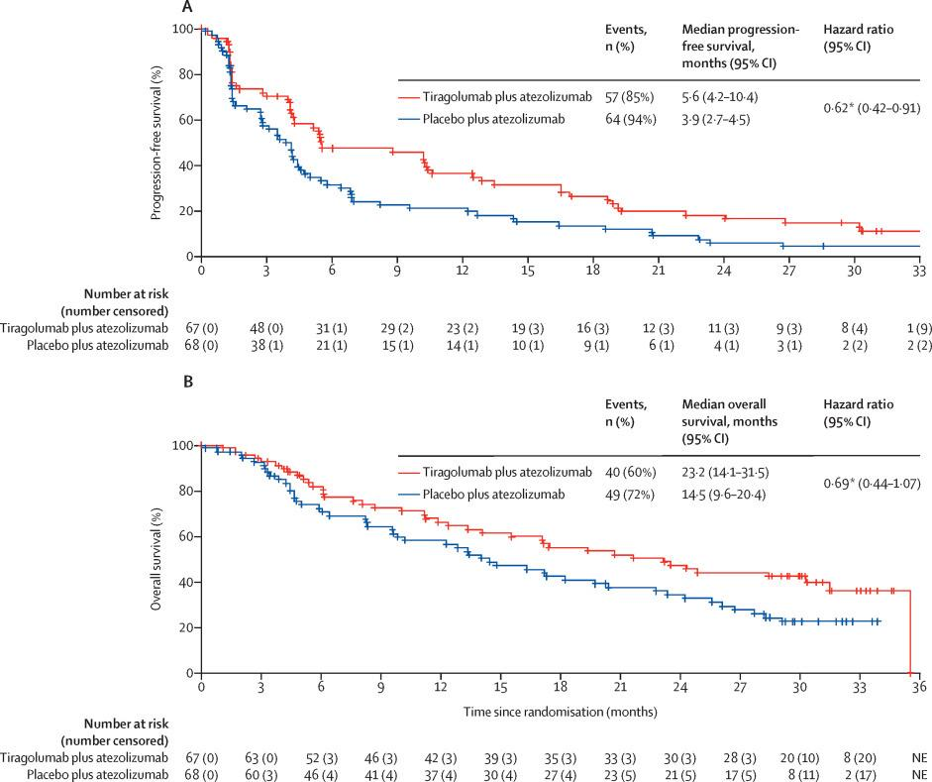

Slide 15
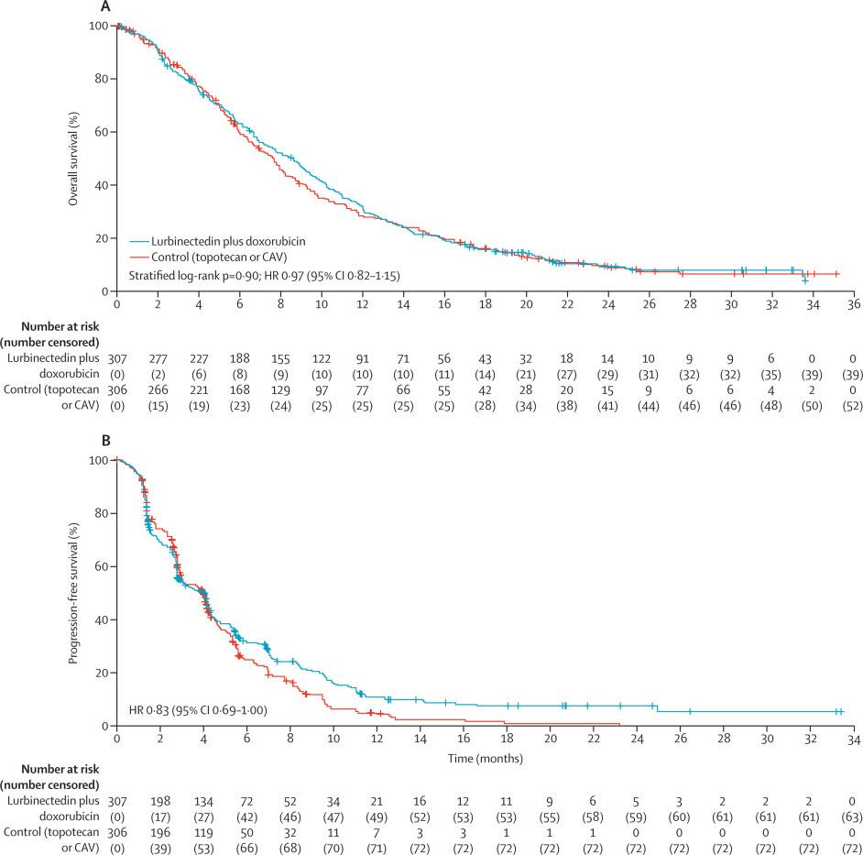

Slide 17
Emerging Treatment Strategies to Propel SCLC and Outcomes
SCLC is almost always attributed to smoking
Precision medicine has not yet improved pts survival due to the lack of actionable mutations !!!
There are no known predictive or diagnostic biomarkers !!!
SCLC classified as a single entity !!!
The only genes Tp53 and RB1 ?????

Slide 18
A NEW ERA
Genetic study using RNA Expression proposed a new classifications and subtypes
ASCL1 ( achaete scute homolog 1 ) SCLC_A
NEUROD1 ( neurogenic differentiation factor 1 ) SCLC_N
POU2F3 ( pou class 2 homebox3 ) SCLC_P
YAP1 ( yes associated protien 1 ) SCLC_I

Slide 19
SCLC subtypes
SCLC_A and SCLC_N. (neuroedocrine ) primary lesion
. Synaptophysin , CD56 , chromogranin
and INSM1 ( IHC )
SCLC_P ( non_neuroendocrine ) . nodal and metastatic
. Lack of NE markers
SCLC_I ( immune_infiltrated ) . Vimentin ,axl and low CDH1
. Chemoresistance and
immunosensitive

Slide 20
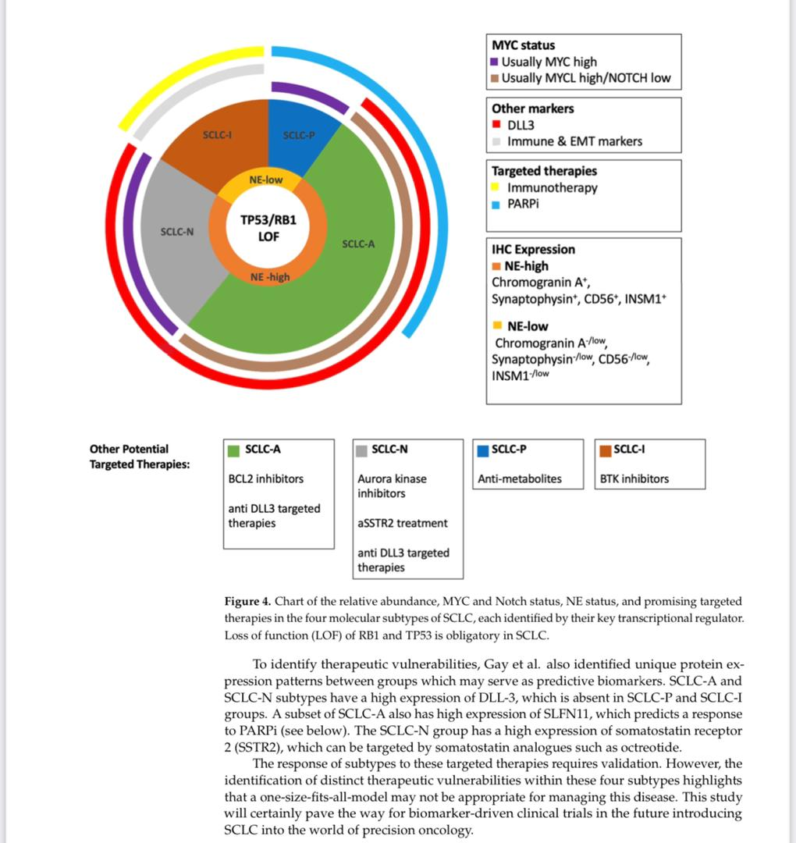

Slide 29
REFERENCE
NCCN GUIDELINES
DEVITA_HALLMAN
ASCO POST
PEERVIEW
NCI
ISALC
THE LANCET ONCOLOGY
CLINICAL CARE OPTION

